Slide 1
Digital Identity Priority Stream
Sophia Howse, BC
Jackie Stankey, Ab

Slide 2
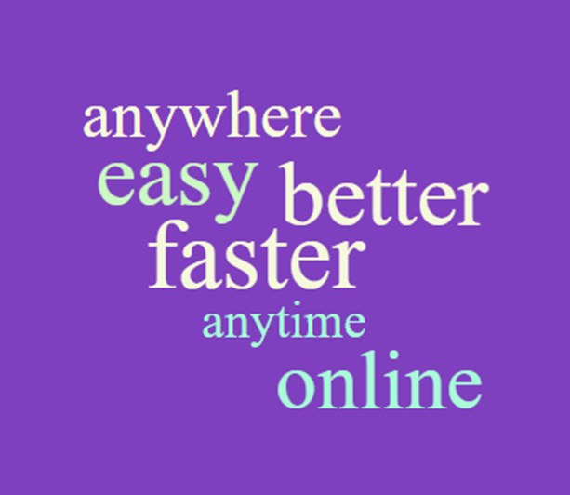
Why does Digital Identity Matter?
Identity Management is critical to success – It is the foundation of moving more services online. We need to be able to verify someone’s identity in a completely digital environment

Slide 3
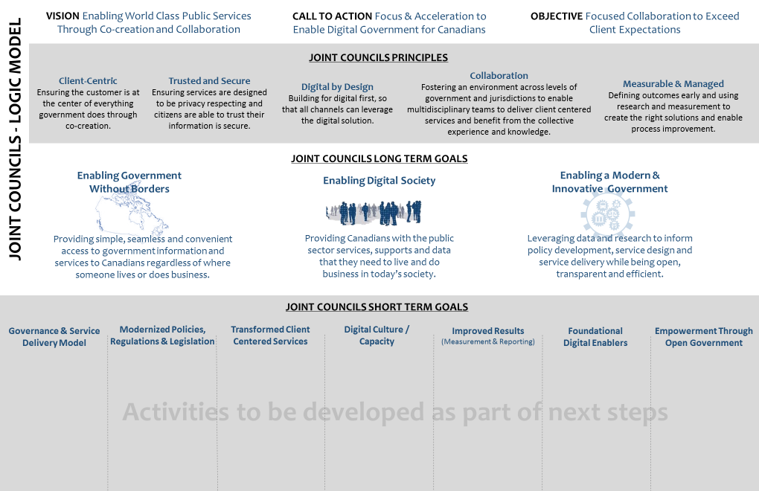
Joint Councils – Logic Model

Slide 4





Digital ID Roadmap
POLICY AND GOVERNANCE
PAN-CANADIAN TRUST FRAMEWORK
PILOTS AND PUBLIC LAUNCHES
TECHNOLOGY
COMMUNICATION AND COLLABORATION

Slide 5
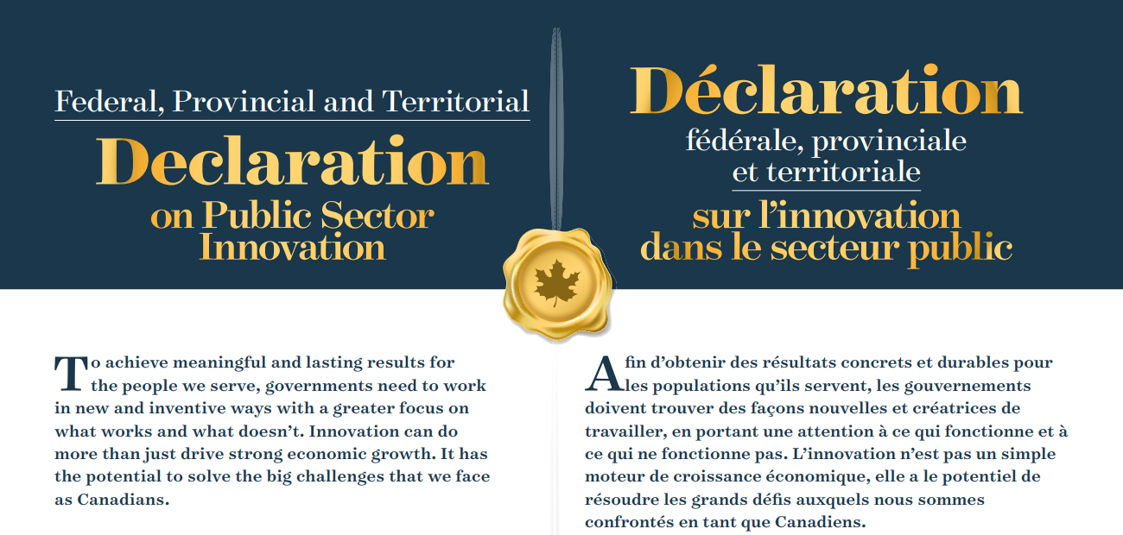
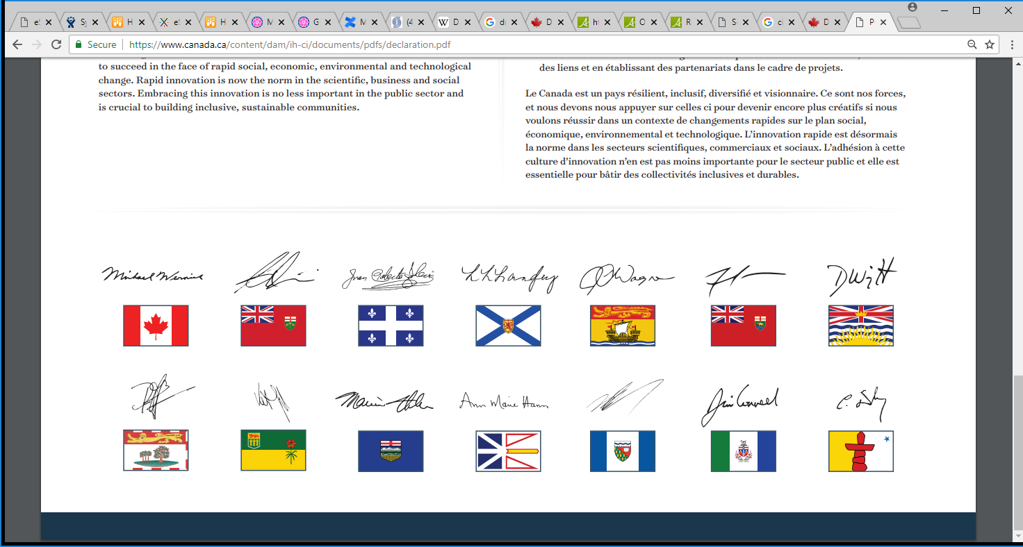
Policy and Governance
Notes:
AB/BC to update

Slide 6
Policy and Governance
We strive to build a society that reflects the digital identity roadmap’s five streams:
Our emphatic support of digital identity forms the foundation of the service outcomes that Canadians expect and need
Notes:
AB/BC to update

Slide 7

Pan-Canadian Trust Framework
Trust framework: a set of agreed on definitions, principles, conformance criteria, assessment approach, standards, and specifications.
TB Directive on Identity Management
Notes:
IMSC to update

Slide 8



Pan-Canadian Trust Framework
Trusted Digital Identity
Initial PCTF focus has been on use cases for individuals…
… now broadening PCTF focus to use cases for organizations.
MADI PILOT
Focus of VO WG & VON
Is it you providing your personal identity information?
Is it a real organization?
Is it the same person?
Is it a real existing person?
Verified Login
Verified Person
Confirmation, Binding, Notice and Consent
Verified Organization
The set of trusted processes that uniquely identifies a real and existing person, ensure that identity information is accurate and up-to-date, and that claims and actions can be attributed to this person
The set of trusted processes that ensures that a user is securely signed-in and acting on his or her own behalf
The set of processes that are used to verify that an organization is real, identifiable, and can truthfully claim that organization’s identity.
The set of trusted processes that binds a verified login to a verified person through confirmation, binding, notice and consent.
Pan-Canadian Trusted Infrastructure Component Security, Privacy, User Experience, Communications
Notes:
IMSC to update

Slide 9
Pan-Canadian Trust Framework
In progress:
Incorporating lessons learned and feedback from pilots and Alpha Testing (AB and BC); Reviewing proposed changes from DIACC
Next Steps:
Develop toolkit for PCTF assessment and acceptance for use by digital identity programs
-Finalize verified person consultation draft
-Consultation within Canada and Internationally (Digital 7)
-Finalize verified person component for PCTF Beta Version
Verified Person
The set of trusted processes that uniquely identifies a real and existing person, ensure that identity information is accurate and up-to-date, and that claims and actions can be attributed to this person
Notes:
IMSC to update

Slide 10
Pan-Canadian Trust Framework
Milestones:
7 presentations and 10 use cases, outlining how organizations are currently verified
Alpha tested trusted processes and conformance criteria across 9 jurisdictions and 11 programs / services
Alpha testing results communicated to members and incorporated into the latest version
In Progress:
IMSC sub-working group conducting final review (target date for endorsement September 2018)
Next Steps:
IMSC to review and provide comments for ratification
Explore real-world application of trusted process through a proof of concept
Verified Organization
The set of trusted processes that are used to verify that an organization is real, identifiable, and can truthfully claim that organization’s identity
Notes:
IMSC to update

Slide 11
Policy and Governance
Policy: Digital Identity Components
Creating an Identity
ID Assurance
Credential Assurance
Notice and Consent
ID Enrolment
Using an Identity
Service Access
Notes:
BC to update

Slide 12
Policy and Governance
Policy: Guiding Principles
International human rights cannot be compromised
Privacy and security must be safeguarded
Convenience and choice for citizens must be delivered
Notes:
BC to update

Slide 13
Pilots and Public Launches
Holding place for ISED Demo of Verified Org - TBC
Notes:
ISED to update once confirmed.

Slide 14
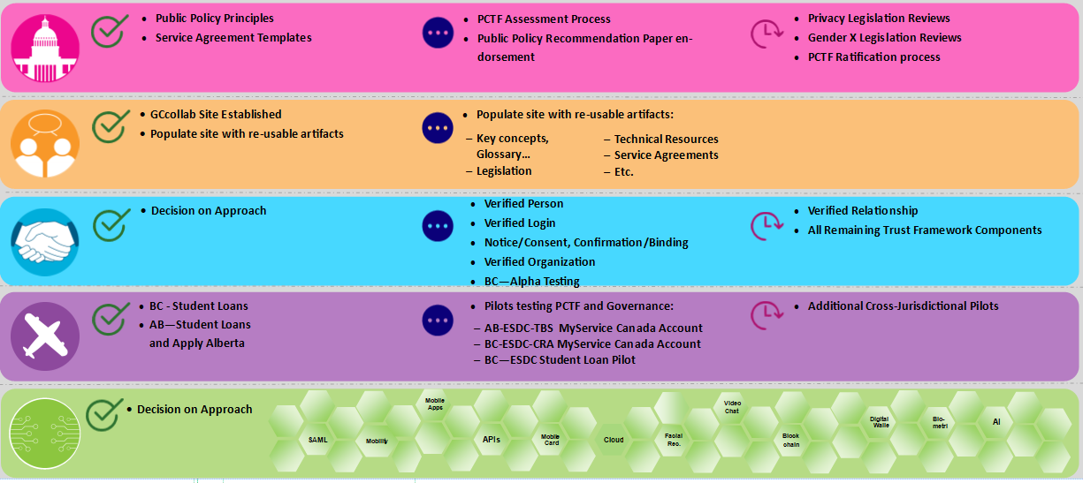
Digital ID Roadmap
Notes:
Insert updated roadmap

Slide 15
Communication and Collaboration
How to socialize Digital ID in jurisdictions
What is working well in your jurisdictions?
What barriers have you encountered?
How do we further awareness?

Slide 16
Communication and Collaboration
Update to Clerks and Cabinet Secretaries
Key Messages?
Approach?
Any requests, etc.?

